Slide 1
Electric water heater
By: Rania Ahmed
Yasmine Mostafa
Youssef Ibrahim

Slide 2
How does it work?
The system is initially at rest waiting for the on button to be pressed.
It constantly measures the temperature by a sensor and controls the cooler and the heater accordingly
Temperature is displayed using a 7 segment
Increase temperature increases temperature by 5 degrees
decreases temperature decreases temperature by 5 degrees

Slide 3
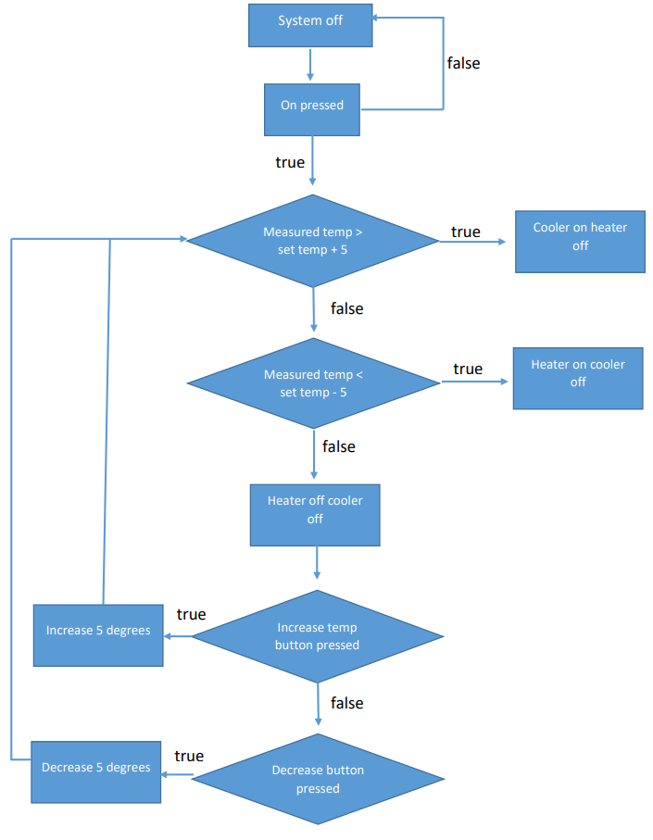
Flow chart

Slide 4
Layered architecture
Layered architecture consists of 3 modules
Mcal: software module that has direct access to all the on-chip MCU peripheral modules and external devices
Hal: contains the hardware devices such as inputs and outputs
App: contains the main file illustrating how the system works

Slide 5
Layered architecture: Mcal
mcal
Bit_maths
DIO_interface
DIO_register
timers
i2C
Std_types

Slide 6
Layered architecture: hal
hal
External_eeprom
Heating_led
On_off
Up_down
Seven_seg
Temp_elements
Temp_sensor

Slide 7
Hardware needed
Temperature sensor: LM35
EEPROM
Heater: oven
Cooler: fan
7 segments
Push buttons
Atmega32 microcontroller

Slide 8
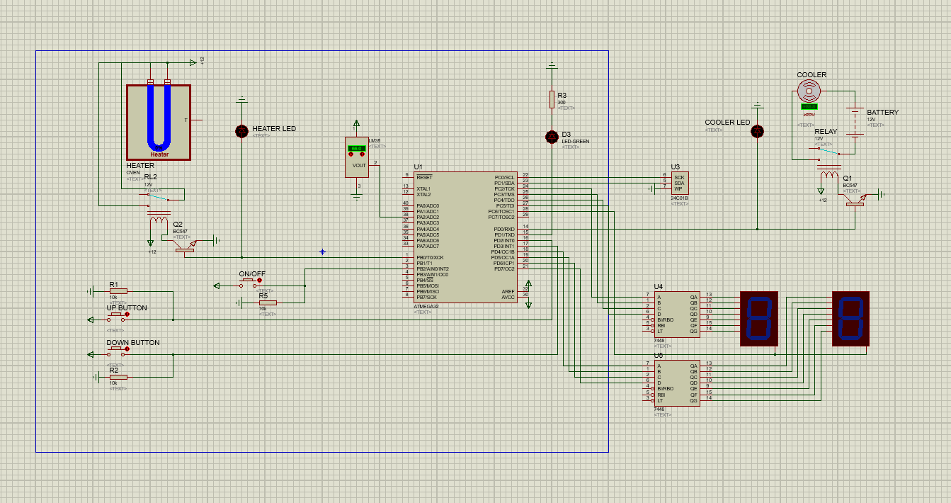
Proteus

Slide 9
Thank you

